Slide 1
MSE – 803 – Data Analytics
Week 12 – Activity 1
Sales Data
Andre Benedetti
28/06/2026

Slide 2
Sales - Dataset
This data set contains sales data from 2 diferente Branches A & B, at three cities.
It has 1000 data, showing customer_type (member/not member), gender, product_name (5 diferente products), product_category (5 categories), unit price, quantity, total price and taxes.
No missing values or outliners were found.

Slide 3
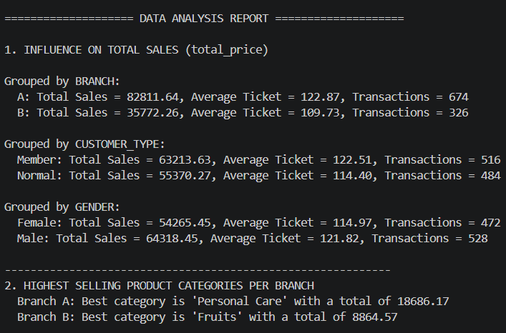
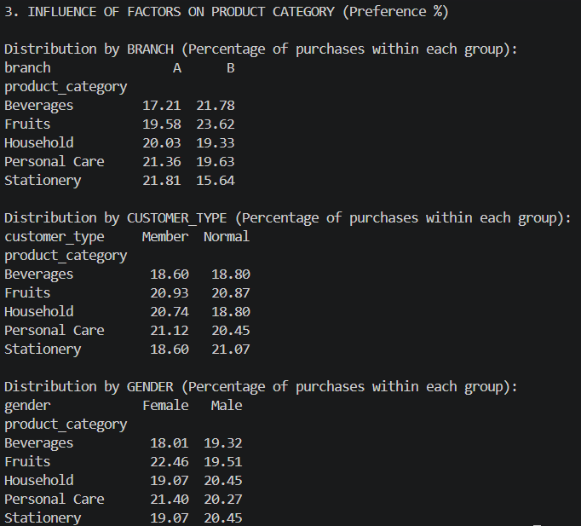
Sales - Information

Slide 4
Sales - Knowlodge
Branch A has twice the sales of Branch B, with similar average ticket. It is presente in two cities and has almost twice the transactions.
Branch A has almost 43% of its sales in Personal Care and Sationaries.
Branch B has almost 45% in Fruits and Beverages.
Males have more transactions with a higher average ticket.
Members of the fidelity program have a Higher buying ticket than the non member.

Slide 5
Sales – Insights
Open a new Branch
Promote the fidelity membership
Higher stock of Personal Care and Sationaries at Branch A and a Strong supply chain of perishable Fruits and Beverages at Branch B.
Category-based promotional campaigns must be localized by branch.

